Slide 1
CIS 560 Final Project

Slide 2
Team Members
Scott Mason
Zack Nelson
Fernando Velarde

Slide 3
Overview
Purpose
Technical details
Target Users
Future expansion

Slide 4
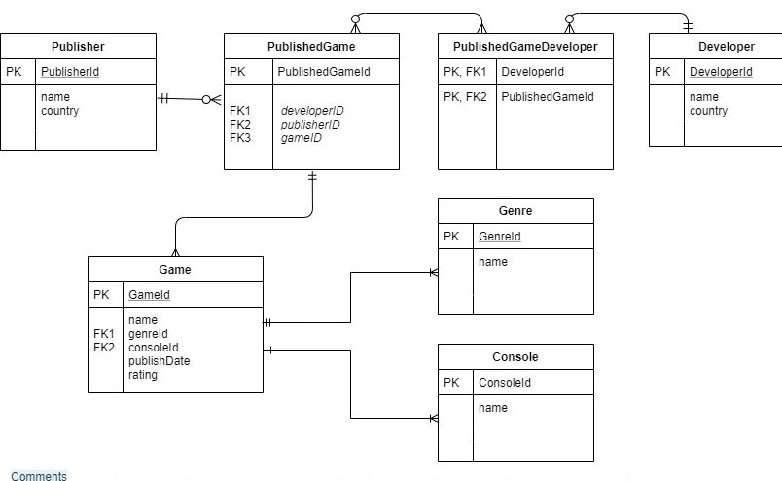
ERD

Slide 5
Questions?

